Slide 1
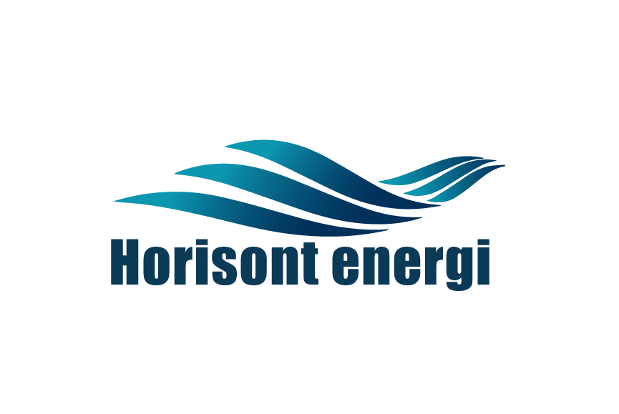
Green Ammonia Project Finnmark
November 2021

Slide 2
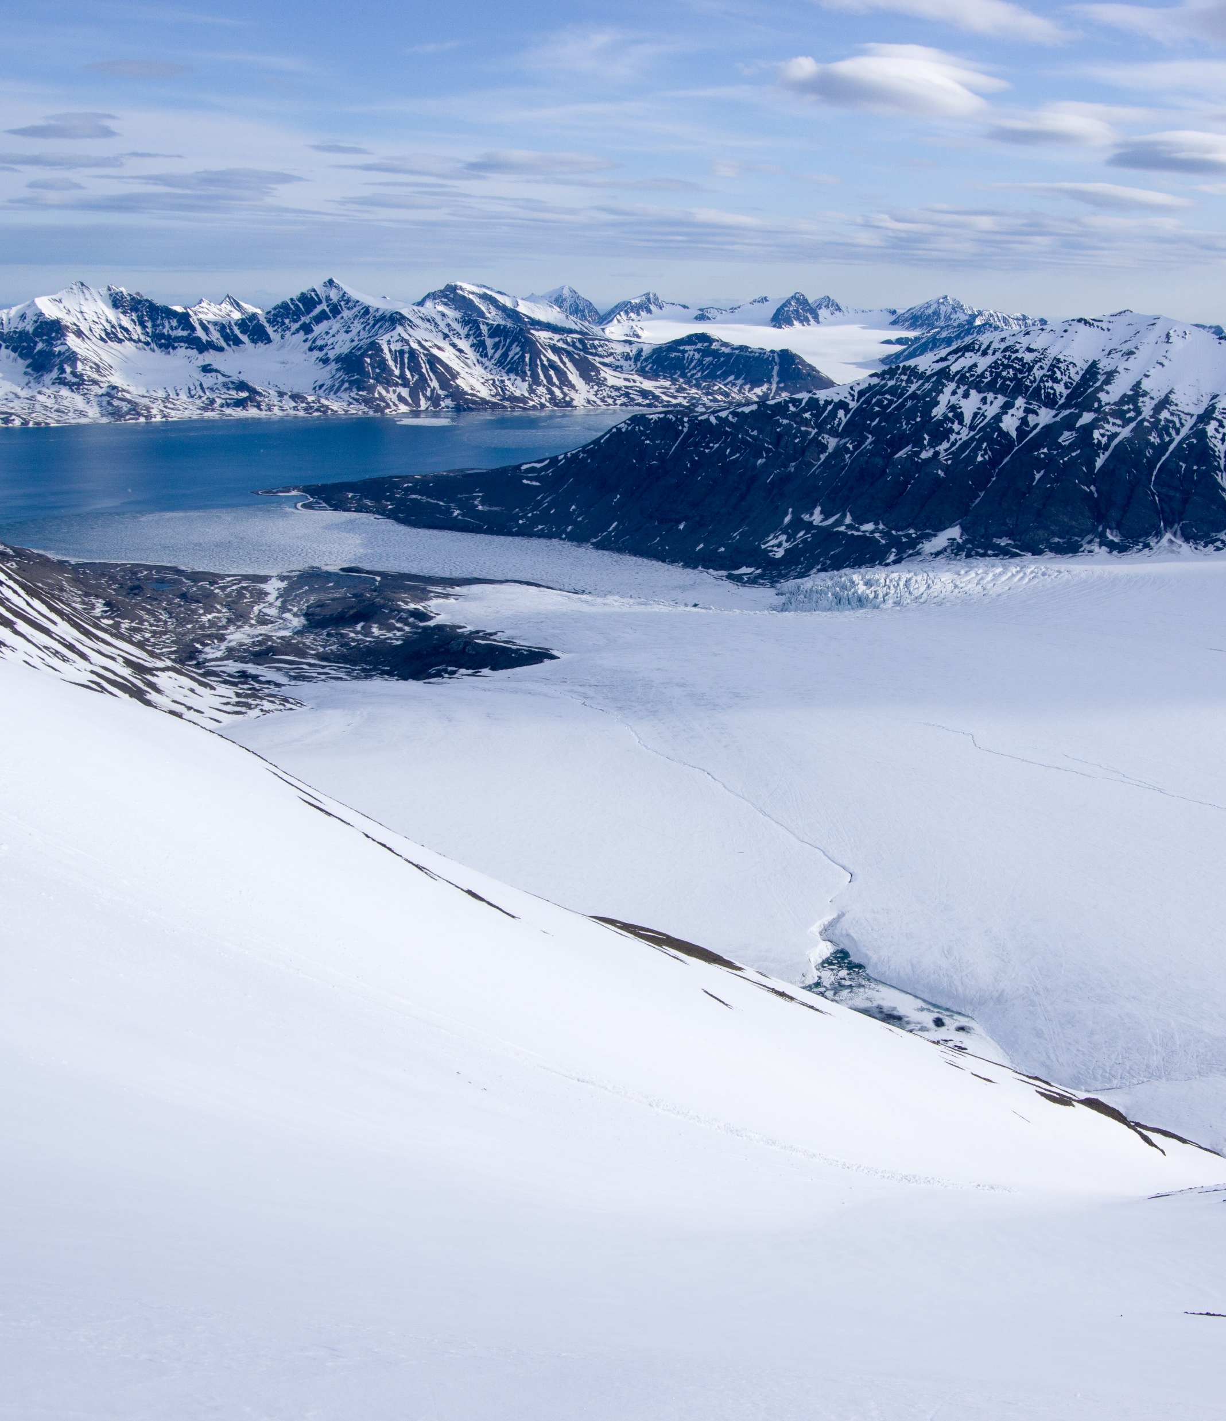
Key project ambitions
Developing the most cost effective and energy efficient green ammonia plant globally
Low carbon and environmentally friendly plant
Use of several renewable energy sources
High focus on sustainable solutions and circular practices
Focus on low noise level and gentle light design
Efficient winterisation utilising the benefit of the cold in the process
Highly modular construction strategy with minimal impact on site

Slide 3
Why clean ammonia?
Ammonia contain about 3 times higher energi density than hydrogen (MJ / L)
Shipping of ammonia is ¼ the price of hydrogen ($/T km)
Substantial growth expected in traded market from 2020 mainly in new sectors
+400 million tonnes of new ammonia demand from marine fuel by 2050
The Japanese power sector are driving development of ammonia use (+30 million tonnes)
Fertilizer and chemical
+97million tonnes of new ammonia demand from current demand segments by 2050
Power sector
+30 million
tonnes of new ammonia demand from Japanese power sector
Marine fuel
+400 million
tonnes of new ammonia demand from marine fuel by 2050
2020
2020
2050
Sources: Argusmedia.com: “The Hydrogen Economy: Going Green”, May 2021. Notes: Power generation expected to grow beyond Japan only.

Slide 4
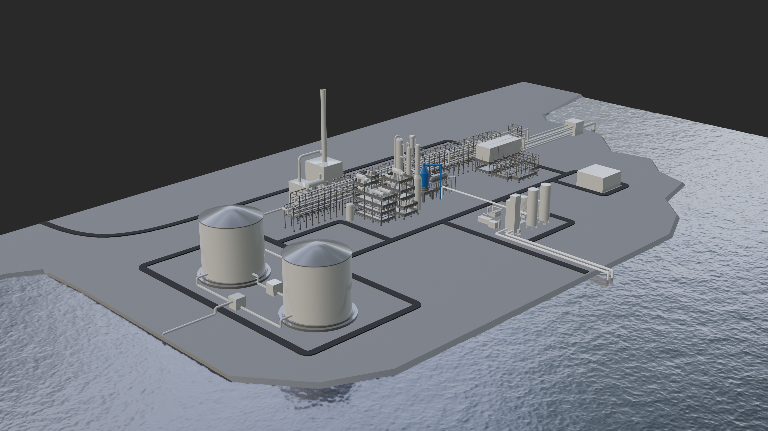
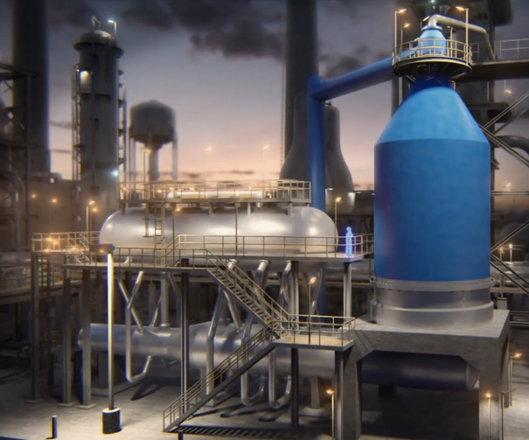
Green Ammonia project in Finnmark Medium scale clean hydrogen and ammonia
New Green Ammonia Project Plant
MARITIME FUEL
Green Ammonia Plant
CHEMICAL INDUSTRY
FERTILIZER
POWER
Finnmark
Renewable CO₂
HYDROGEN
AMMONIA
Renewable energy

Slide 5
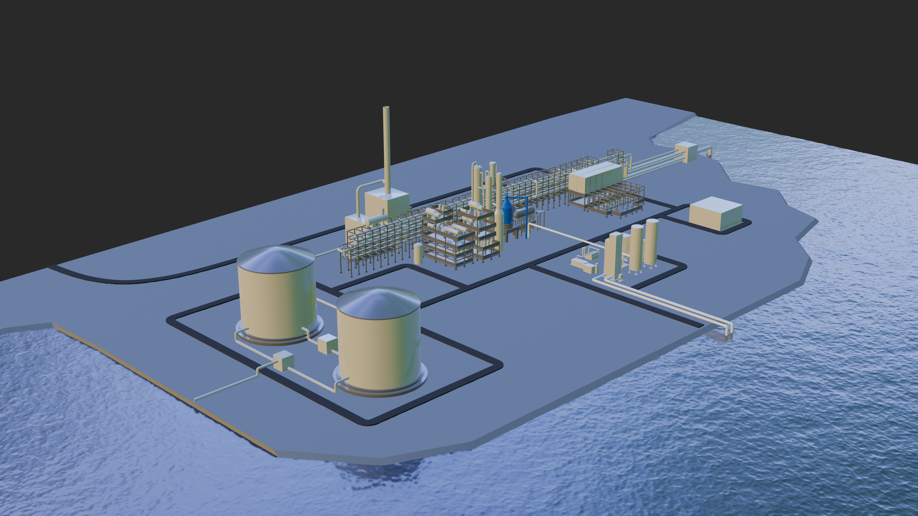
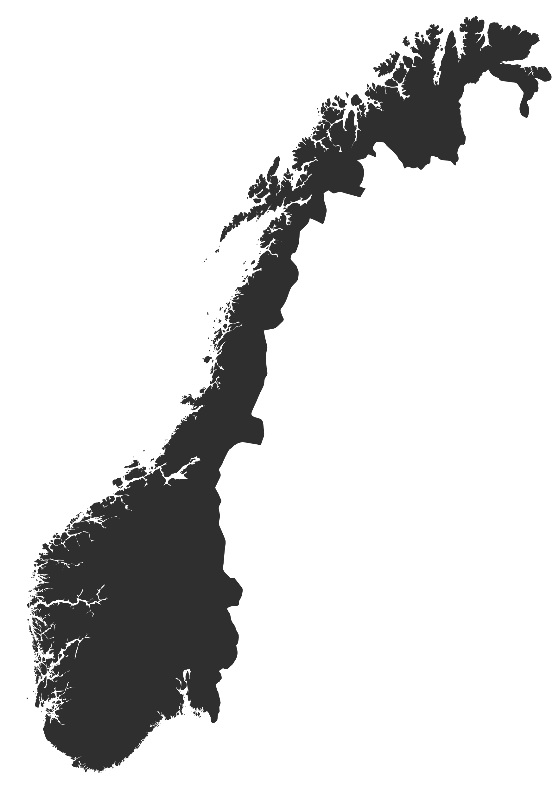
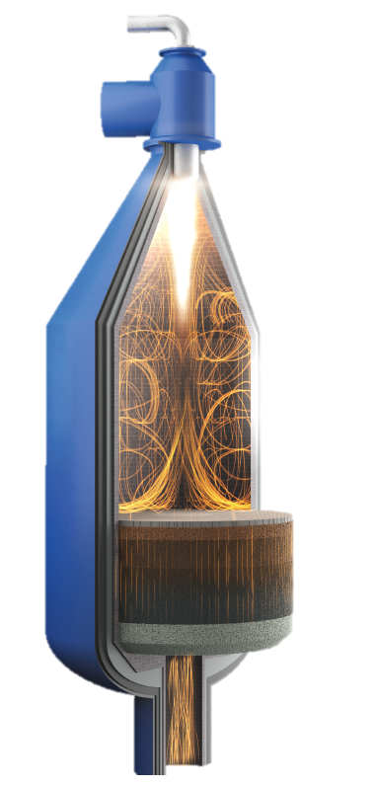
Green Ammonia project
Green Ammonia Plant
Production data
Green hydrogen, 164 tons/d
Green ammonia, 911 tons/day
350.000 tons CO₂/year

Slide 6
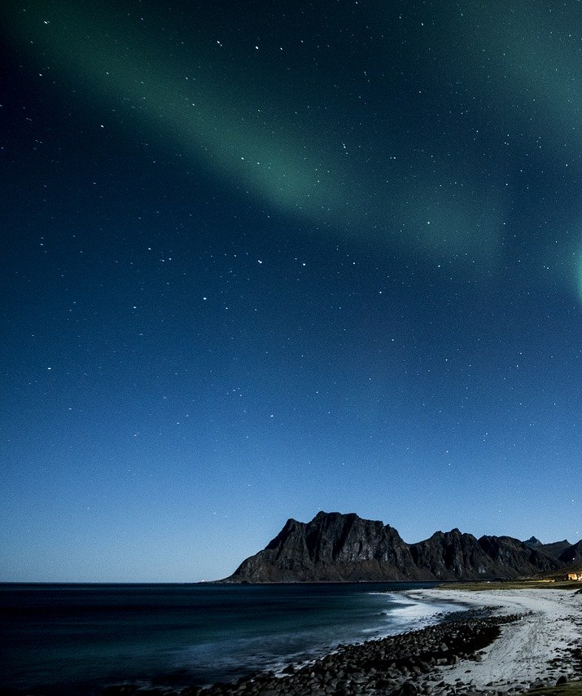
Site selection criteria
Access to deep water port, or possibility for development of such, very good marine conditions
Access to power grid
Access to freshwater (process water) and seawater (cooling water)
Overview of other activities in the area (Cabins, recreation areas, national parks, reindeer herding etc.)
Site should measure a minimum of 300 acres, but preferably with expansion possibility for about 1000 acres to accommodate future development and development of industry clusters.

Slide 7
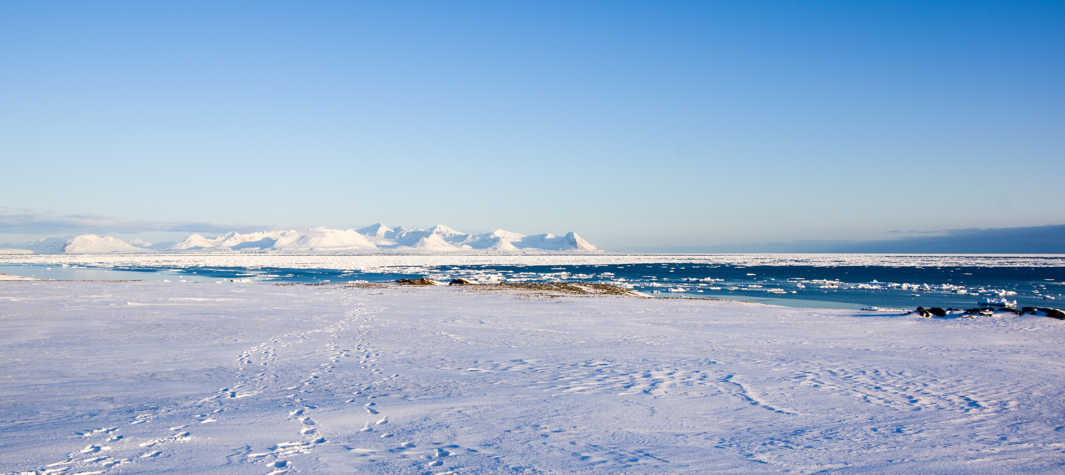
Timeline
High level Schedule
2021
2022
2023
2024
2025
Shaping phase
Next steps
Project shaping & framing
Site selection & civil screening
Conceptual design
Energy sourcing screening
Pre-studies
Planned set-up

Slide 8
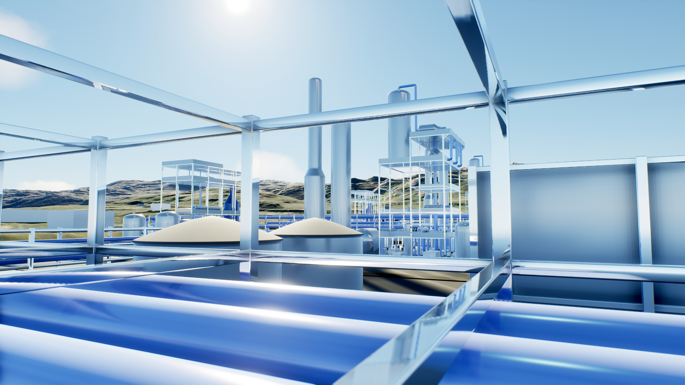
Highlights
Early mover in large-scale green ammonia production
Value chain to Rotterdam planned for
Aiming for attractive economics
Strategic partnership in place
Experienced and committed teams

Slide 9
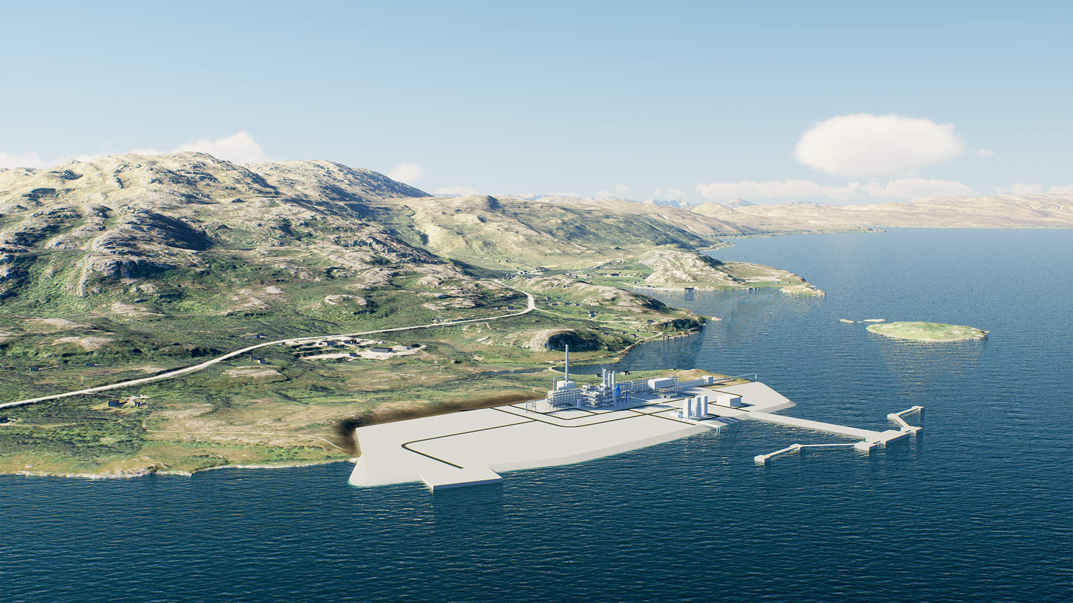
“
ACCELERATING THE TRANSITION TO CARBON NEUTRALITY THROUGH PIONEERING PROJECTS
THANK YOU

